Slide 1

T0-DO LIST
Presented By:
Iswarya Sathyan
Shubham Rathi
Pavan Kumar G

Slide 2

What is To-do-List?
It’s a list of tasks you need to complete or things that you want to do.
Most typically, they’re organized in order of priority.

Slide 3

Why To-do-List is Important?

Slide 4

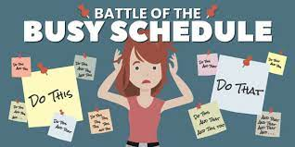

Slide 5



Depression:

Slide 6
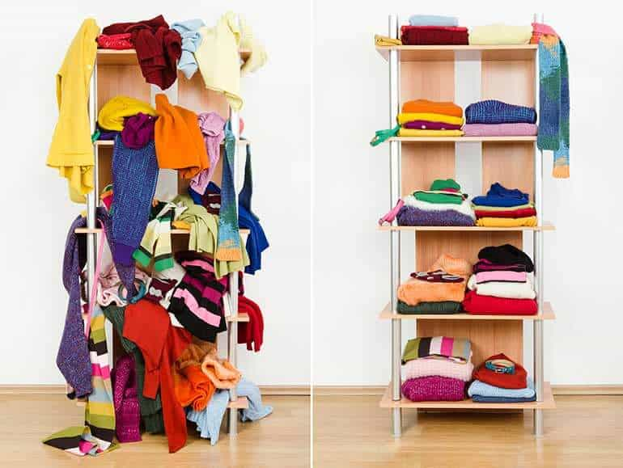
Un- Organized
Organized

Slide 7
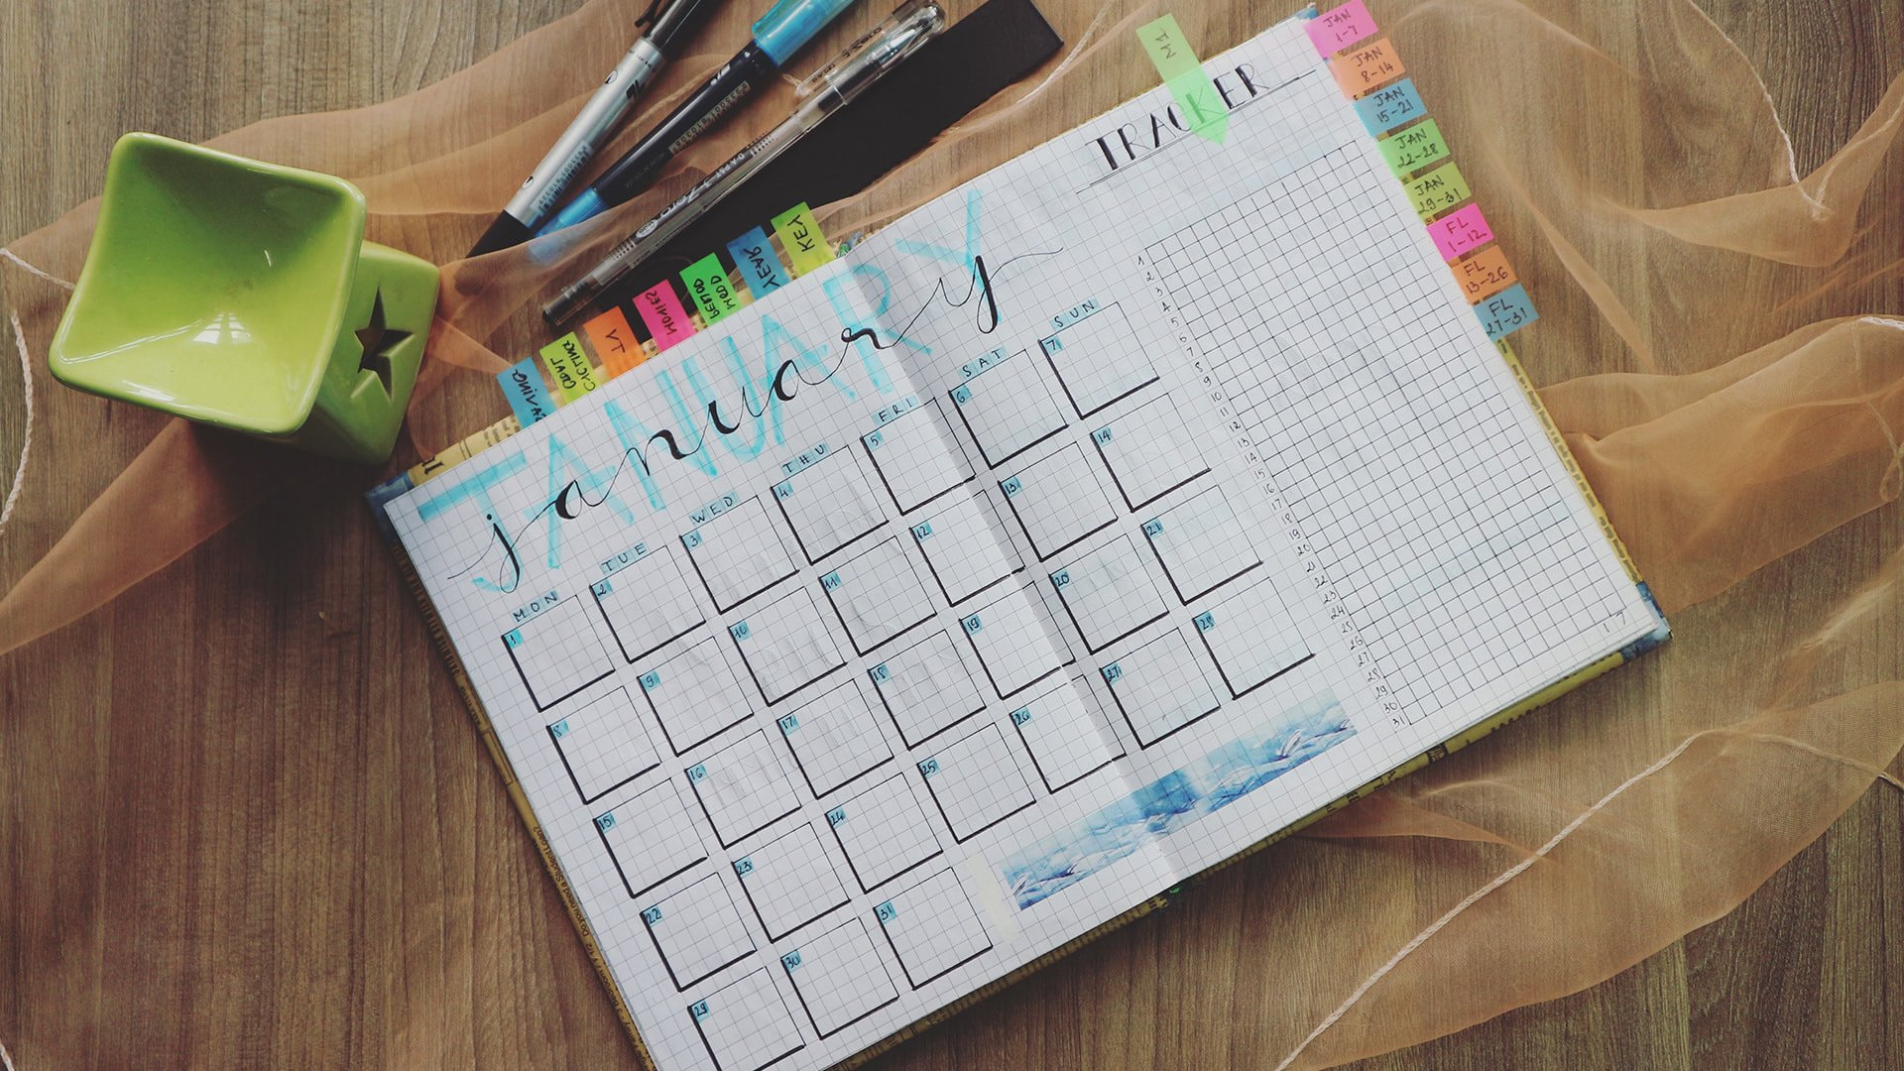
Writing in Dairies

Slide 8


Slide 9


Slide 10

Presenting Our Application:
TO-DO LIST

Slide 11

About Our Application:
One of the Best Application to manage all your tasks.
You can Add and schedule your tasks easily.
You can Update, delete the existing tasks.
Get Reminded about the incompleted tasks.
Categorize your tasks based on the priority.
Delete Your tasks after completion.

Slide 12
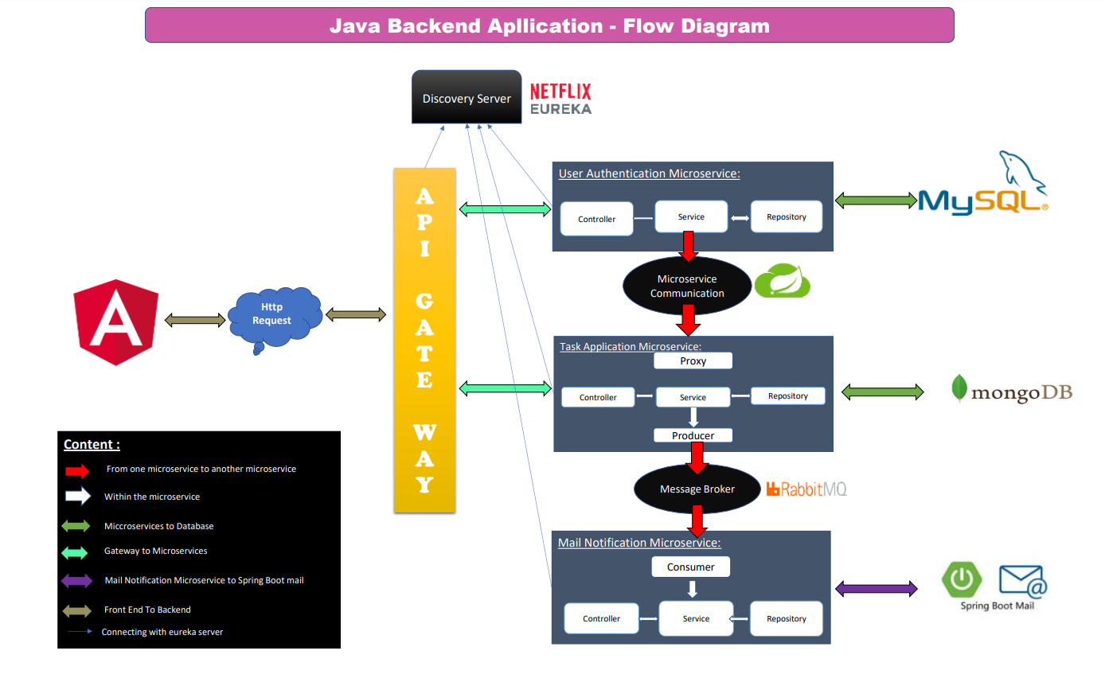

Slide 13

Microservices
Microservices are an architectural and organizational approach to software development where software is composed of small independent services that communicate over well-defined APIs.

Slide 14
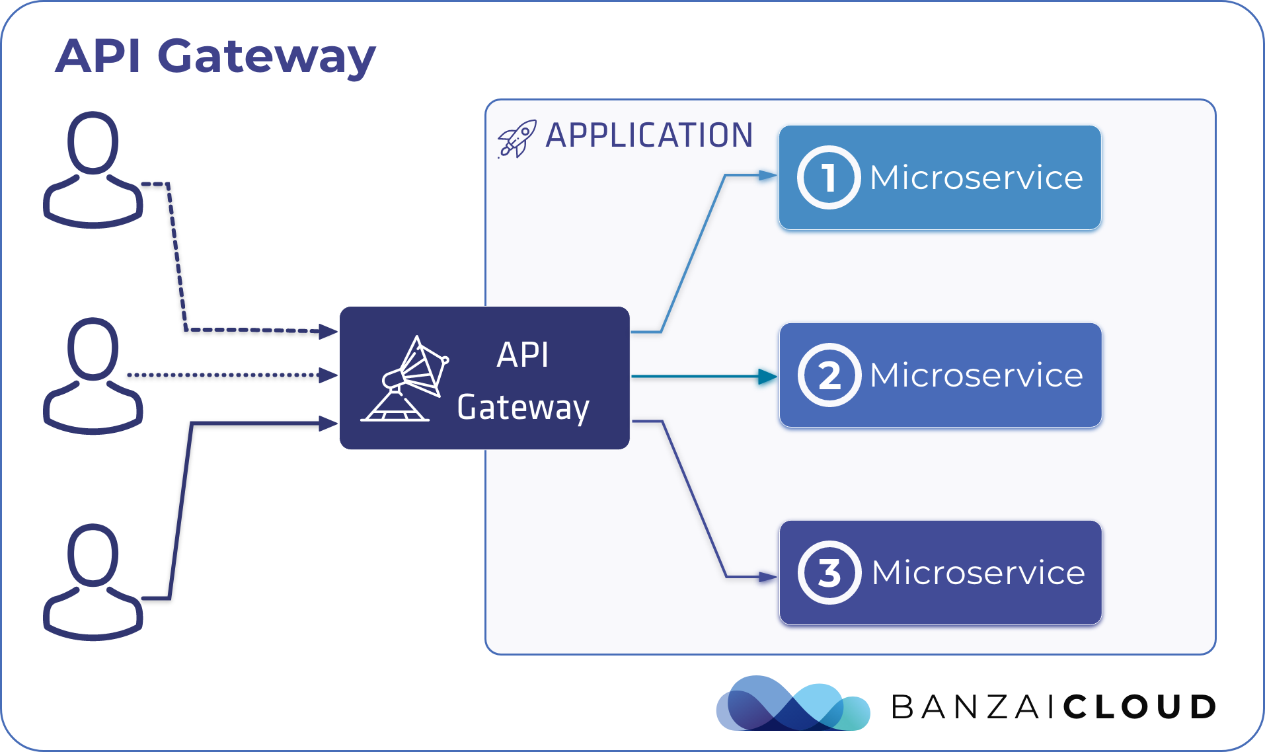
API Gateway :
Provides a Single Endpoint or URL for the client apps and then internally maps the request to a group of internal microservices.

Slide 15
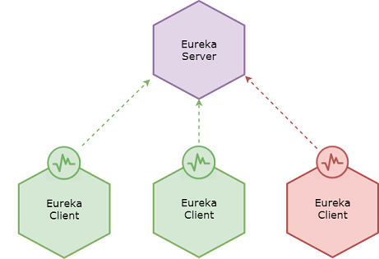
Eureka Service :
Every Micro service will register into the Eureka server. It knows all the client applications running on each port and IP address.

Slide 16
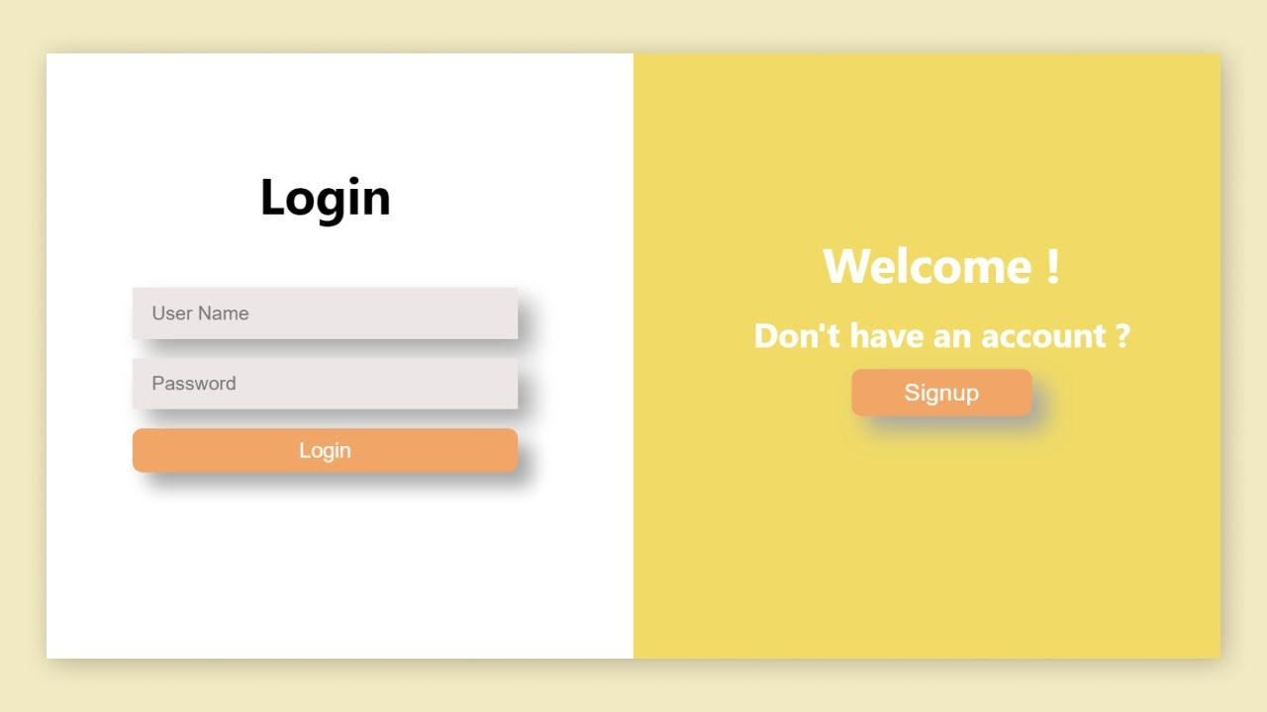
Authentication Service :
Registering and Authentication will takes place here and if authentication is success, we can perform task operations.

Slide 17
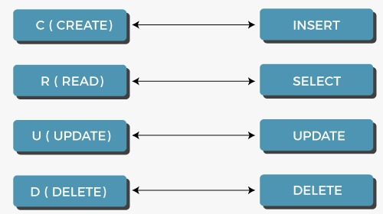
Task Service :
All the task Task Operations will takes place in this service.

Slide 18

Mail Notification Service :
Sends Notification to the Users Email when they register successfully.
If the user forgot password they’ll get the password to the registered Email.

Slide 19
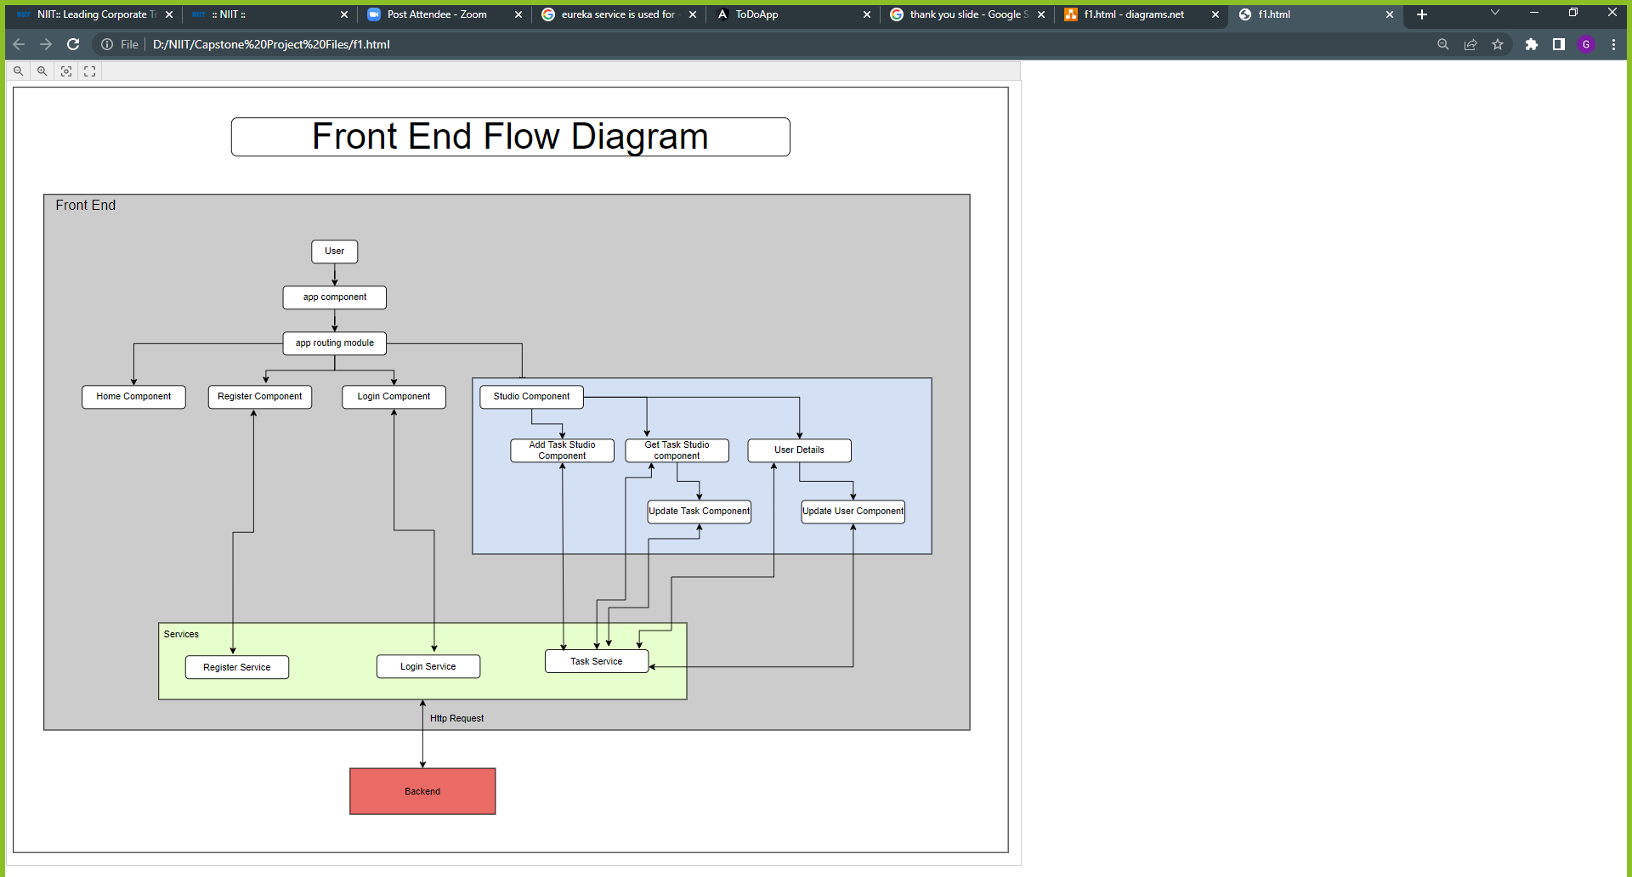


Slide 20

Tools and Technologies

Slide 21




Front End
1. HTML
2. Cascading Style Sheets (CSS)
3. BOOTSTRAP
4. ANGULAR

Slide 22






Back End
1. Java
2. Feign Client
3. Rabbit MQ
4. Spring Boot
5. API Gateway
6. Eureka Server

Slide 23


Data Bases
1. My SQL
2. Mongo DB

Slide 24

How Our Application Looks like….

Slide 25
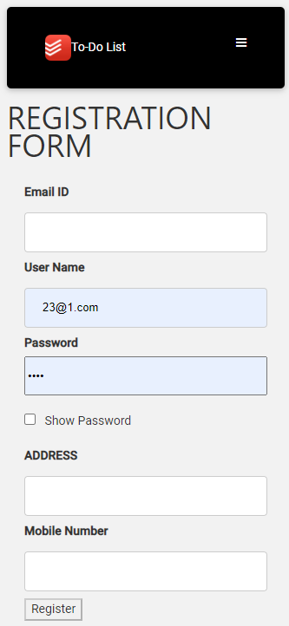
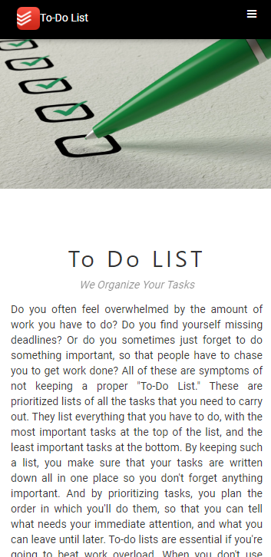
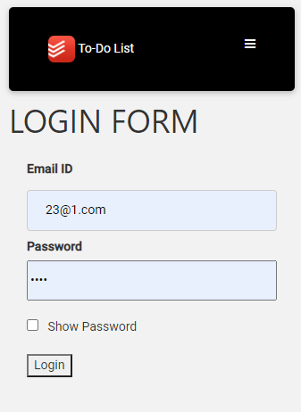
Home Page

Slide 26
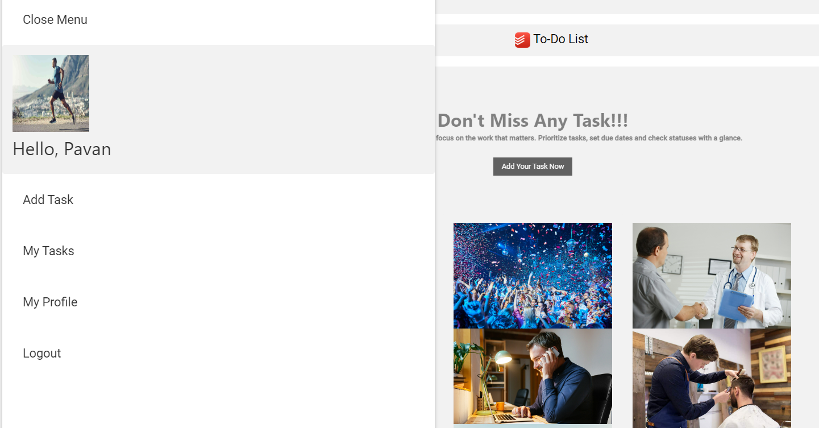
Main Menu
Profile Picture
User Name
Side Navigation Bar

Slide 27
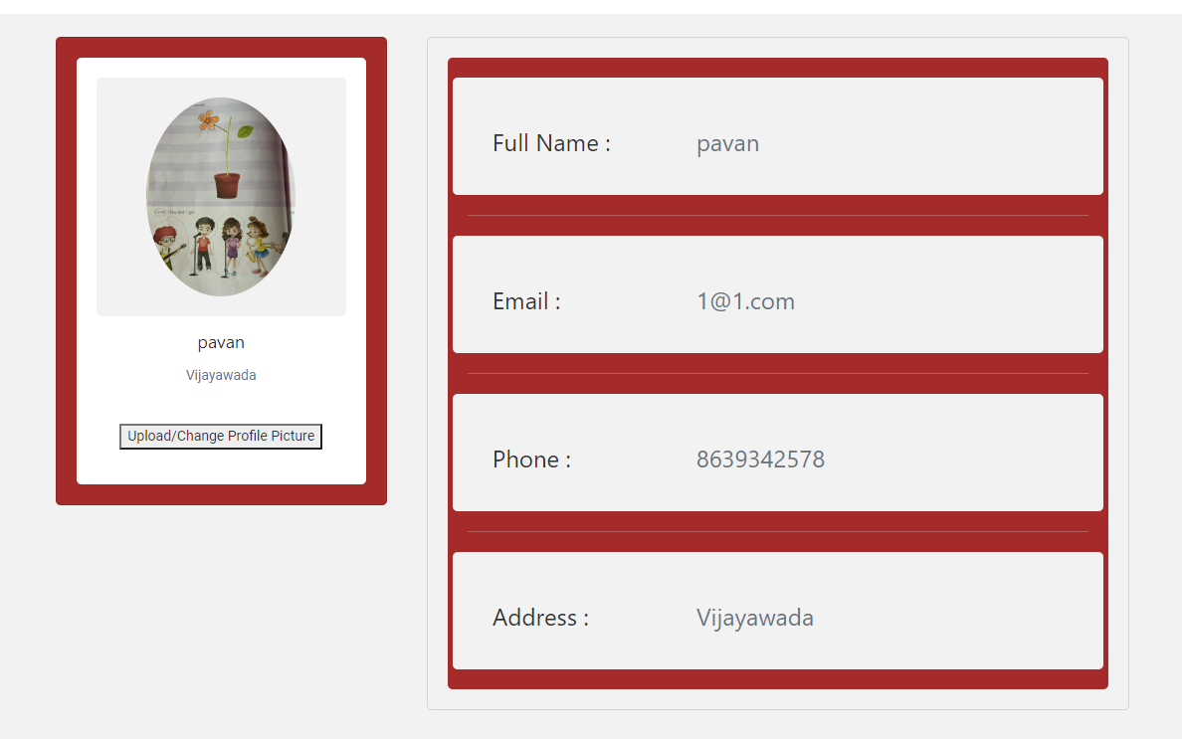
User Details

Slide 28
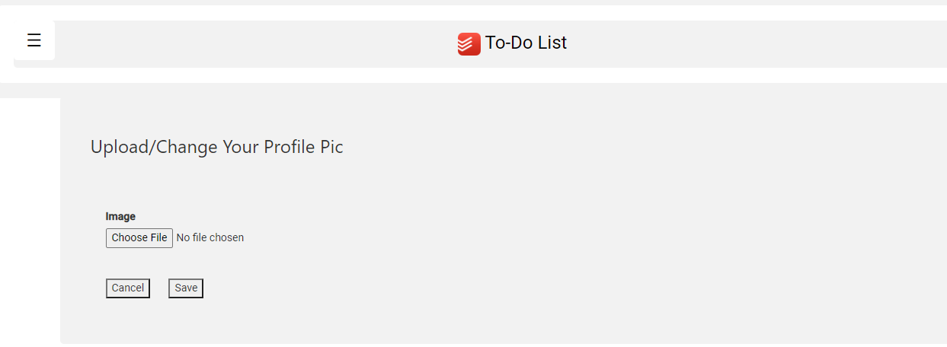
Upload/Change Profile Picture

Slide 29
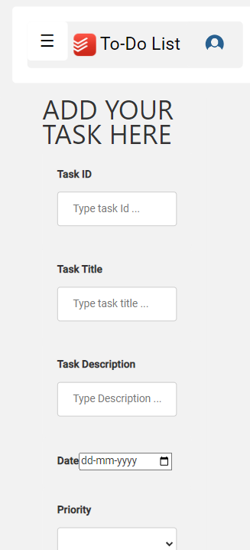
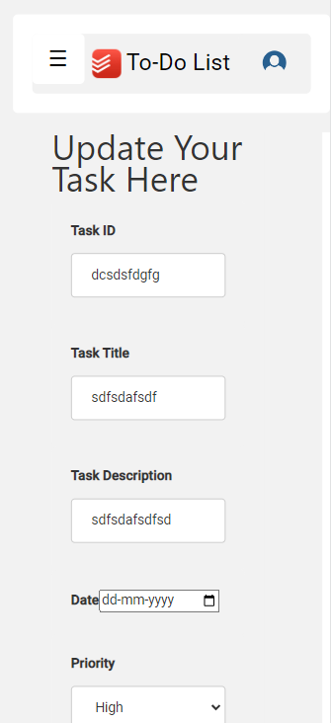
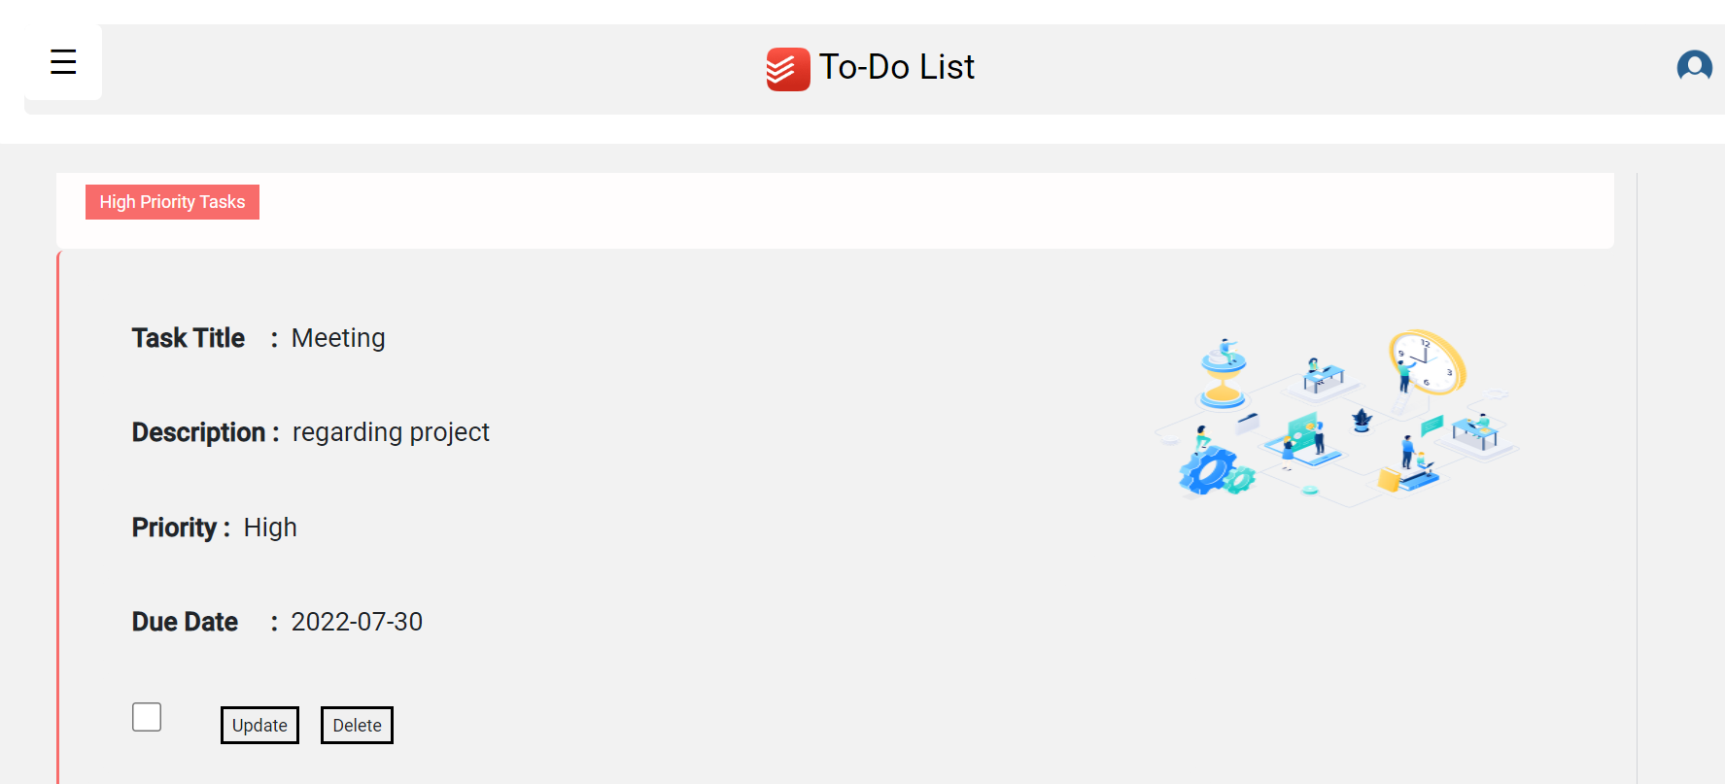
Task Operations
3
1
2
4

Slide 30
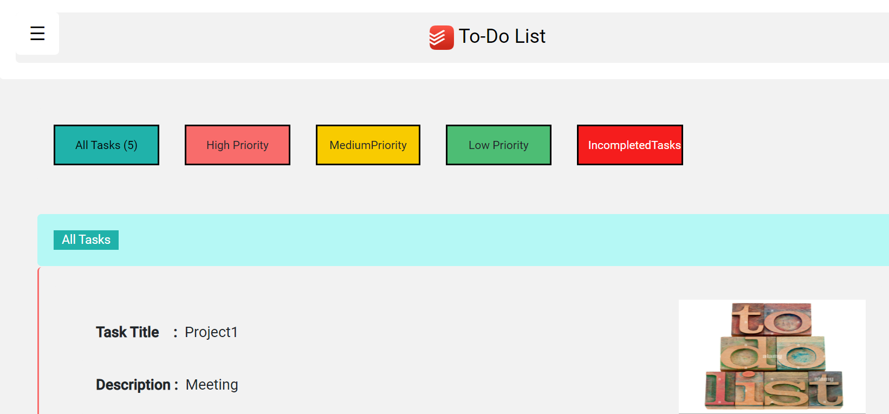
Categorize Tasks:
Count

Slide 31
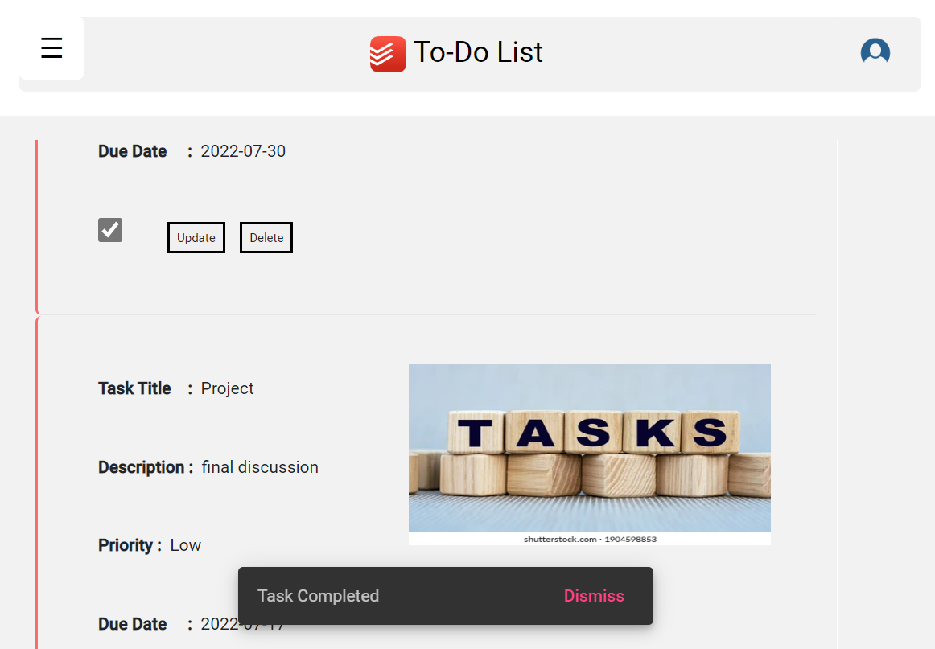
Deleting the Completed Task
1
2
3

Slide 32
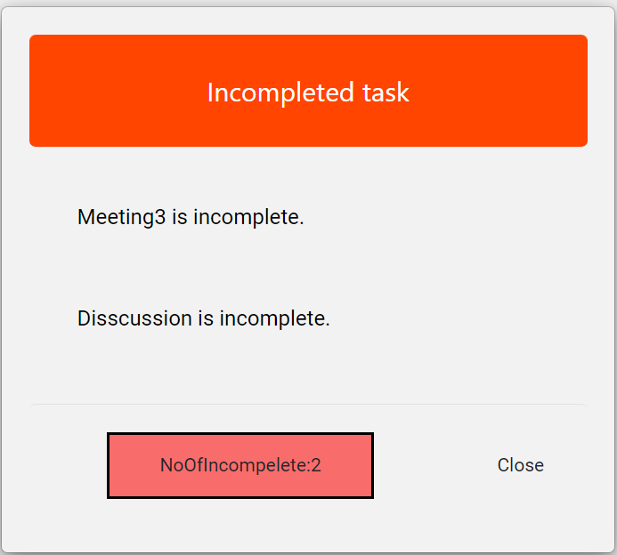
Showing Incomplete Task

Slide 33

Let’s Check………..

Slide 34

Any Questions???

Slide 35


